Slide 1
Why not consider a career in Dentistry?

Slide 2
Is this you?
Interested in healthcare
Like helping people
Enjoy working with your hands
Like working as part of a team
Have good concentration
Enjoy talking to lots of different people
Good organiser
Enjoy continually learning new things…
… If so, you could enjoy a career in dentistry.

Slide 3
You could be a:
Dental Assistant Dental Therapist
Practice Manager Dentist
Dental Hygienist Dental Technician
Oral Health Therapist
Dental Prosthetist

Slide 4
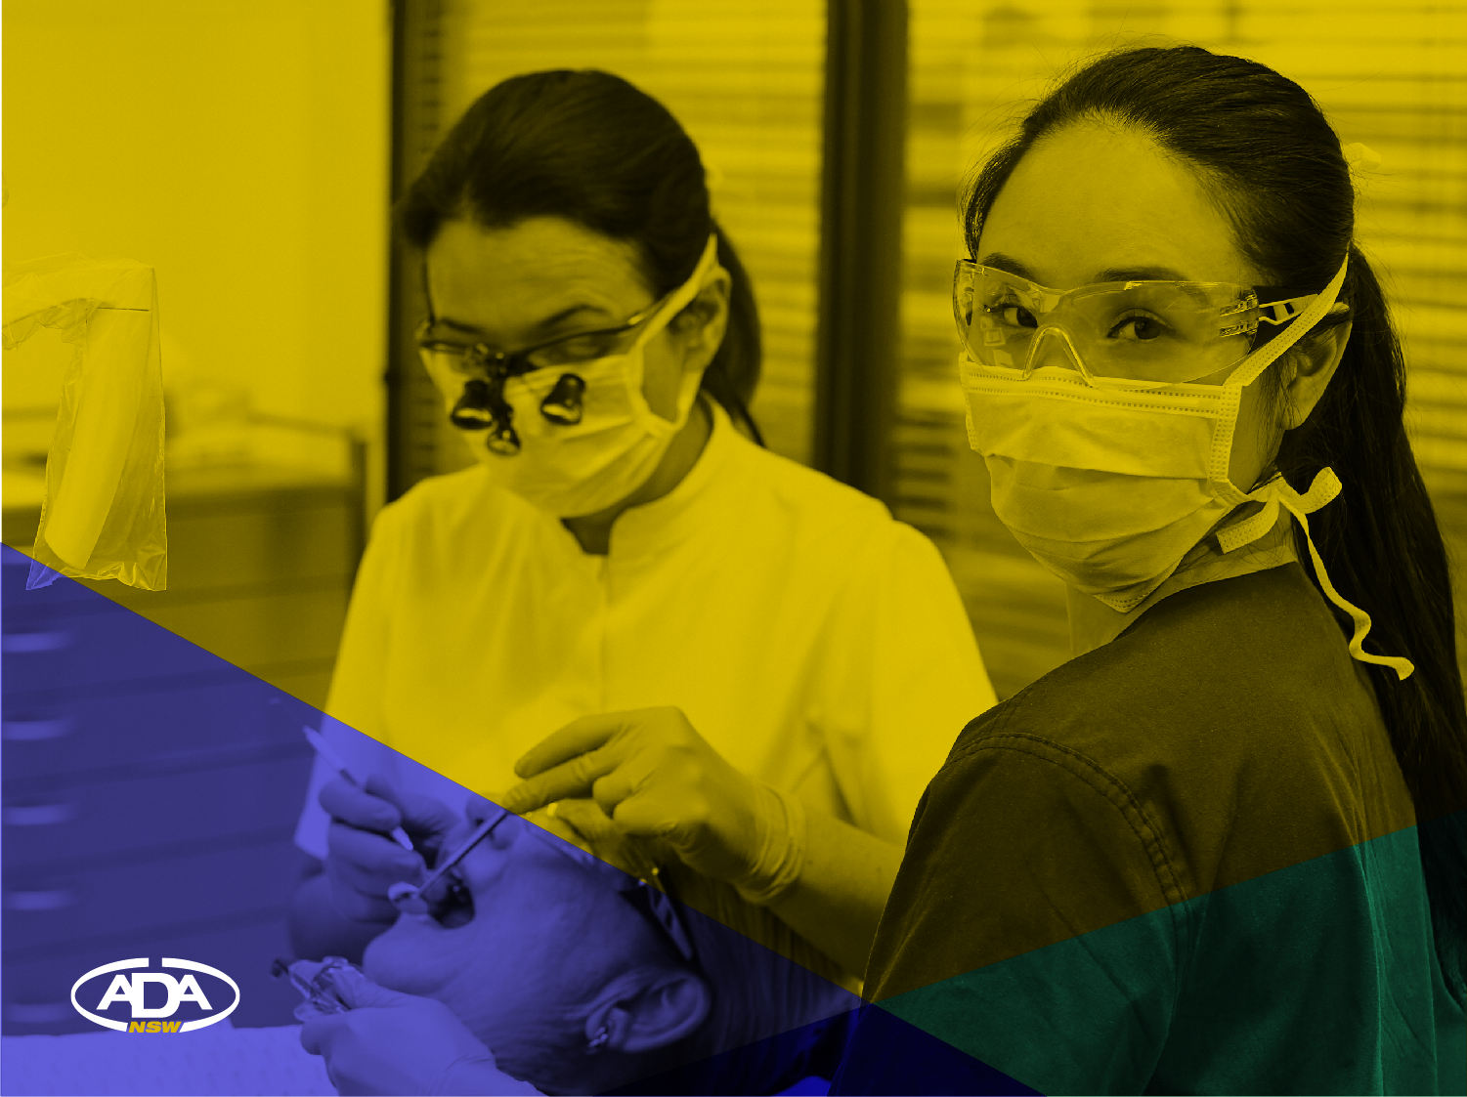
Dental Assistant

Slide 5
What does a Dental Assistant do?
Assists dentists during clinical treatment
Greets patients and helps put them at ease
Prepares the dental surgery and dental materials
Carries out infection control procedures such as sterilising equipment
Updates patient records, processes x-rays and carries out other administrative duties
With advanced training, Dental Assistants can:
Take x-rays and other clinical dental imaging
Deliver oral hygiene instruction and diet counselling.

Slide 6
Advantages of being a Dental Assistant
Working in a varied and interesting job
Working as part of a close-knit team
Having an active hands-on role with limited time sitting at a desk
Helping to relieve people’s pain and discomfort
Highly transportable skills with an ability to work all over Australia and in other countries.

Slide 7
How to become a Dental Assistant
On the job training for dental assisting can be provided. Formal training options include a Certificate III and IV in dental assisting.
Where can you go from there?
Complete a Certificate IV or Diploma of Practice Management to become a Practice Manager
Complete a 3-year Bachelor of Oral Health degree to become an Oral Health Therapist, Dental Therapist or Dental Hygienist
Move into product sales in the dental industry
Teach Dental Assistant courses
Travel: Use your qualification on a working holiday.

Slide 8
Practice Manager

Slide 9
What does a Practice Manager do?
Coordinates appointments and administration for dental office efficiency
Manages dental clinic staff and operations
Bills patients, organises appointments, manages patient records
Markets the practice by, for example, updating the website and sending out e-newsletters
Sometimes a practice manager may also undertake other roles in the dental clinic including reception or assisting duties.

Slide 10
Advantages of being a Practice Manager
Varied and interesting role
Good training in running a business and organising people
Can move into administration in other areas of healthcare
Working as part of a close-knit team
Working with people and helping to put them at ease.

Slide 11
How to become a Practice Manager
Opportunities for formal training as a Practice Manager include a
Certificate IV or Diploma of Practice Management.
Where can you go from there?
Complete a 3-year Bachelor of Oral Health degree to become an oral health therapist, dental therapist or dental hygienist
Move into other administrative or office management roles in the healthcare sector or beyond
Teach Practice Management courses
Travel: Use your qualification on a working holiday.

Slide 12
Dental Hygienist Dental Technician Dental Therapist

Slide 13
What does a Dental Hygienist do?
Provides preventative treatment to children and adults, including scaling, cleaning and polishing teeth
Takes and interprets x­-rays
Takes impressions and makes dental models
Provides fluoride treatment as well as other dental medicaments
Constructs mouthguards and other dental appliances
Provides oral health advice and diet counselling.

Slide 14
What does a Dental Technician do?
Works in a laboratory, constructing, repairing and adjusting dental appliances
Works with dentists to fabricate items such as dentures, crowns, bridges, orthodontic appliances, mouthguards and sleep appliances
Works with various materials including wax, metal, plaster and ceramics
Works with dental prosthetists and dentists, but has no direct contact with patients.

Slide 15
What does a Dental Therapist do?
May have a teaching role, working with other healthcare providers
Collaborates with and refers patients to dentists
Provides dental examinations, oral cancer and tooth decay screenings and saliva testing for young people
Fills and extracts teeth, administers injections and cleans teeth and gums
Takes and interprets x-rays and makes impressions of the teeth for plaster study models and mouthguard construction
Educates young people and their parents about oral healthcare.

Slide 16
Advantages of being a Dental Hygienist, Oral Health Therapist or Dental Therapist
Working independently in a varied, interesting and skilled role, and also working as part of a team
Using clinical, teaching and customer service skills
Relieving people’s pain and discomfort.

Slide 17
How to become a Dental Hygienist, Oral Health Therapist or Dental Therapist
You will need to complete a full-time Bachelor degree available at several universities in metropolitan and regional Australia. These are usually three years in duration.
Where can you go from there?
A Bachelor degree can be used for entry into a postgraduate dental degree
Move into education, research, community work or administration in the oral health or healthcare sectors
Work overseas.

Slide 18
Dentist

Slide 19
What does a Dentist do?
Patient care
Performs dental examinations, provides diagnoses and creates treatment plans to address patient concerns
Provides dental treatment such as restoring teeth, surgery including extractions, periodontal care for gum disease, replacement of missing teeth, diagnosing pathology and managing oral health in patients with systemic disease
Depending on capabilities, provides more specialised dental care
Educates patients on how to prevent oral health problems by teaching skills such as how to brush the teeth and make positive diet choices
Prescribes medications and refers patients to other health practitioners including specialists.

Slide 20
What else does a Dentist do?
Processes and interprets x-rays
Provides education on dental care to the public
Maintains concise, complete and accurate patient dental records
Supervises the rest of the team and is responsible for leading the team in delivering oral health services
Continually educates himself or herself and upgrades skills.

Slide 21
How to become a Dentist
Dentists require a degree to enable them to be registered to practice; there are 11 universities in Australia, New Zealand and Fiji that offer dental training. Some universities require a first degree prior to undertaking a dental training course.
Where can you go from there?
Teach dentistry or become an academic
Specialise in a chosen area of dentistry such as endodontics (focusing on the teeth)
Create and deliver educational programs or get on the speaker circuit
Work in remote areas of Australia or overseas in the community aid or public health sectors.

Slide 22
Other Dental Careers

Slide 23
Dental Technician

Slide 24
What does a Dental Technician do?
Works in a laboratory, constructing, repairing and adjusting dental appliances
Translates two-dimensional diagrams into three-dimensional products such as dentures, implants, mouthguards and crowns
Works with various materials including wax, metal, plaster and ceramics
Works with dental prosthetists and dentists, but has no direct contact with patients.
Works with dentists to fabricate items such as dentures, crowns, bridges, orthodontic appliances, mouthguards and sleep appliances.

Slide 25
Advantages of being a Dental Technician
Working with professionals in a scientific environment
Working in a varied and interesting job using both scientific and artistic skills
Ability to construct dental appliances without the patient being present leading to increased time flexibility with fabrication processes.

Slide 26
How to become a Dental Technician
It is recommended that you complete a two-year Diploma in Dental Technology at TAFE or other accredited institution.
Where can you go from there?
Study further to become a prosthetist, therapist or dentist
Move into other areas of prostheses construction such as post-cancer surgery reconstruction.

Slide 27
Dental Prosthetist

Slide 28
What does a Dental Prosthetist do?
Consults with dentists and patients on constructing and maintaining removable appliances such as dentures and mouthguards
Performs oral health assessments and dental examinations on patients
Makes impressions of the teeth and models of the mouth, teeth and jaws
Is skilled in both the clinical and technical aspects of fitting appliances
May work independently and run their own business
Is a provider recognised by the Australian Government and all private health funds.

Slide 29
Advantages of being a Dental Prosthetist
Working with a wide range of people in a varied and interesting job in a healthcare environment
Using scientific, artistic, clinical and technical skills
Being your own boss
Seeing upfront the positive differences you have made to people’s lives.

Slide 30
How to become a Dental Prosthetist
Firstly, you will need to complete a two-year Diploma in Dental Technology at TAFE or other accredited institution
Complete a two-year part-time Advanced Diploma in Dental Prosthetics at TAFE or other accredited institution.
Where can you go from there?
Teach students at TAFE and university about clinical and technical aspects of dentistry
Become an inventor – develop, patent and produce new dental appliances or production processes
Be a technical advisor or marketing manager for the dental laboratory industry
Research new dental materials.

Slide 31
Thank you

